Slide 1
Parallel Computing with Python
Xiaoyuan Suo

Slide 2
What is Parallel Computing?
“If I can shovel my driveway in 1 hour, how long would you expect it to take if someone equally capable were to help me?”
“If one person can dig a hole with a shovel in 100 seconds, how long will it take for 10 people to dig that hole?”
“Suppose the goal is to plant 100 trees. Each tree requires than you dig a hole, place the tree in the hole, and refill the hole. Assume each of these steps takes 100 seconds.
How long does it take for one person to plant 1 tree?
How about 100 trees?
Suppose 10 people helped plant trees. How long will it take?”

Slide 3
What is Parallel Computing?
Parallel computing is a model that divides a task into multiple sub-tasks and executes them simultaneously to increase the speed and efficiency.
A problem is broken down into multiple parts. Each part is then broke down into a number of instructions.
These parts are allocated to different processors which execute them simultaneously.
This increases the speed of execution of programs as a whole.

Slide 4
What is Distributed Computing?
Distributed computing is a field that studies distributed systems.
Distributed systems are systems that have multiple computers located in different locations.
These computers in a distributed system work on the same program.
The program is divided into different tasks and allocated to different computers.
The computers communicate with the help of message passing. Upon completion of computing, the result is collated and presented to the user.

Slide 5
Difference between parallel and distributed computing?
Parallel computing generally requires one computer with multiple processors.
Multiple processors within the same computer system execute instructions simultaneously.
All the processors work towards completing the same task. Thus they have to share resources and data.
In distributed computing, several computer systems are involved.
In parallel computing, the tasks to be solved are divided into multiple smaller parts. These smaller tasks are assigned to multiple processors.
In parallel computing environments, the number of processors you can add is restricted. Distributed computing environments are more scalable.
In systems implementing parallel computing, all the processors share the same memory. Distributed systems, on the other hand, have their own memory and processors.
Parallel computing is often used in places requiring higher and faster processing power. For example, supercomputers.

Slide 6
Why PDC?
The primary goal of parallel computing is to increase available computation power for faster application processing and problem solving.
It will save you time
It will allow you to solver larger problems.
It’s here whether you like it or not!
Parallel and distributed computing (PDC) can be found in research and industries of many science and engineering domains.
You will have a good chance to obtain better internships if you master the concepts well

Slide 7
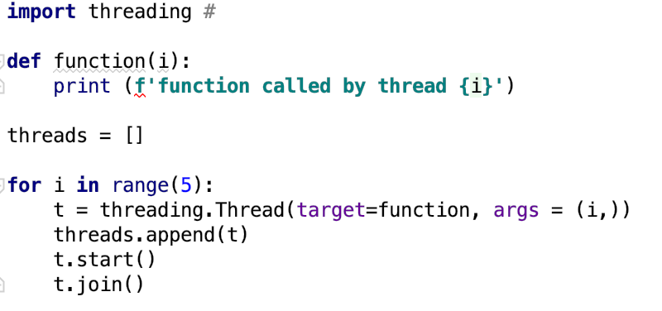
Thread Basics
Define a Thread
Thread is an independent execution flow that can be executed parallelly and concurrently with other threads in the system.
Notes:
Unplugged activity:
Bogaerts used this analogy to explain the notion of thread join operation. Suppose a parent and their child are out for a walk along a trail in their local park. The child decides to travel off the path to pick flowers. While the parent can go on for some time without the child, eventually they will call out to the child to catch up: “Come now, please join me up here”. The parent will then wait for their child to join up with them, and then the two continue walking up the path together.
This is analogous to a main thread calling the join() operation on a child thread. Thread A blocks until B is finished; only then can A continue with their work.

Slide 8
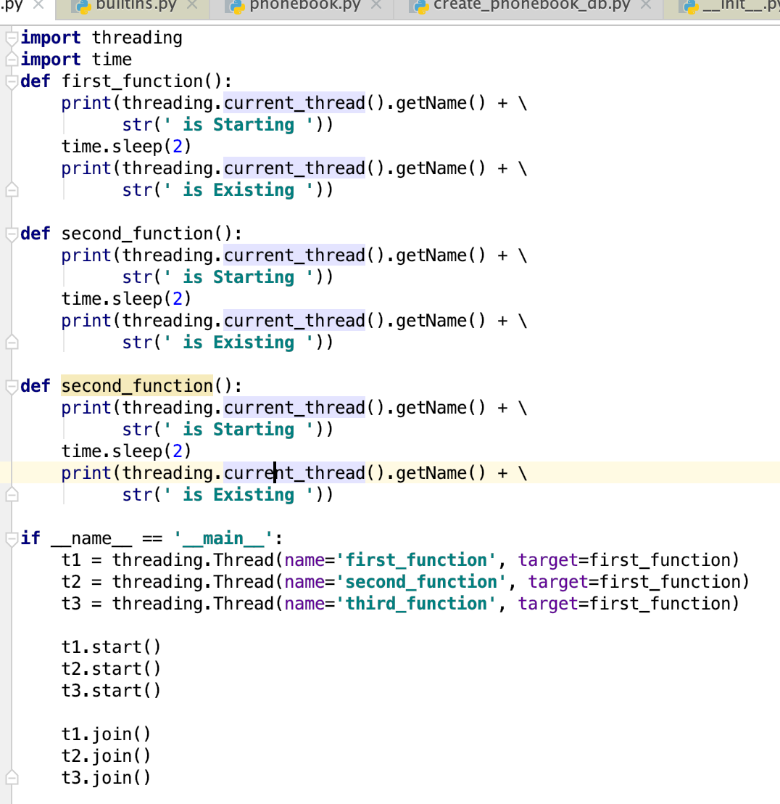
How to determine the current thread
Notes:
Using arguments to identify or name the thread is cumbersome and unnecessary. Each thread instance has a name with a default value that can be changed as the thread is created. Naming threads in useful in sever processes with multiple service threads that handle different operations.
first_function is Starting
second_function is Starting
Thread-1 is Starting
second_function is Existing
Thread-1 is Existing
first_function is Existing

Slide 9
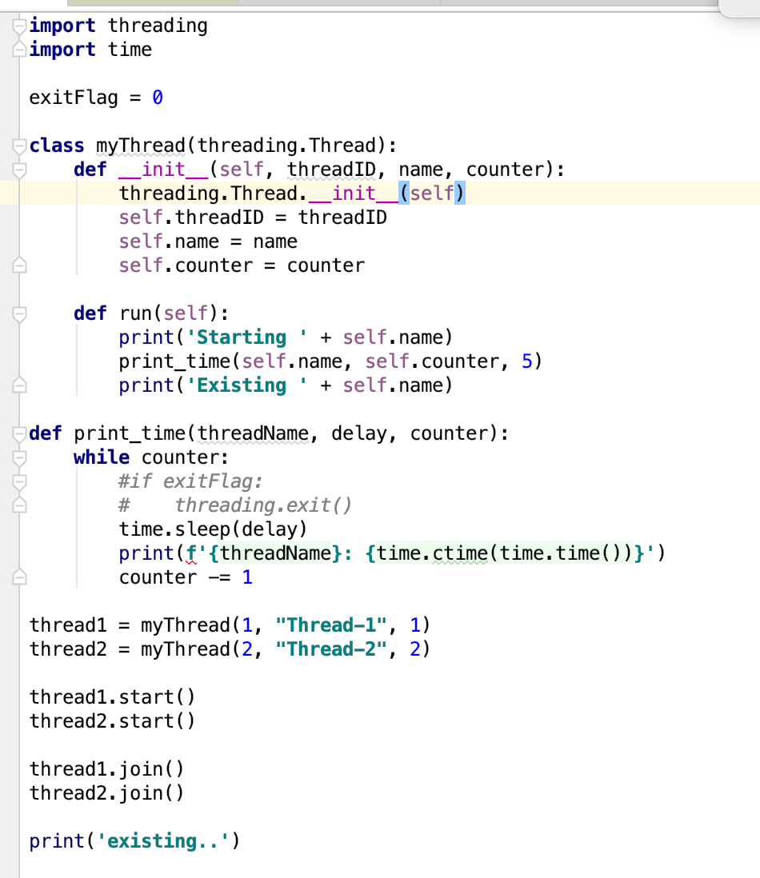
Use Thread in SubClass
Notes:
To implement a new thread using the threading module, you have to do the following
Define a new subclass of the thread class
Override the __init__(self [,args]) method to add additional arguments
Then you need to override the run(self, [args]) method to implement what the thread should do when it is starting.
Once you have created the new Thread subclass, you can create an instance of it and then start a new thread by invoking the start() method, which will, in turn, call the run() method.
The threading module is the preferred form for creating and managing threads. Each thread is represented by a class that extends the Thread class and overrides its run() method. Then, this method becomes the starting point of the thread. In the main program, we create several objects of the myThread type; the execution of the thread begins when the start() method is called.
Calling the constructor of the Thread class is mandatory—using it, we can redefine some properties of the thread as the name or group of the thread. The thread is placed in the active state of the call to start() and remains there until it ends the run() method or you throw an unhandled exception to it. The program ends when all the threads are terminated.
The join command just handles the termination of the threads.

Slide 10
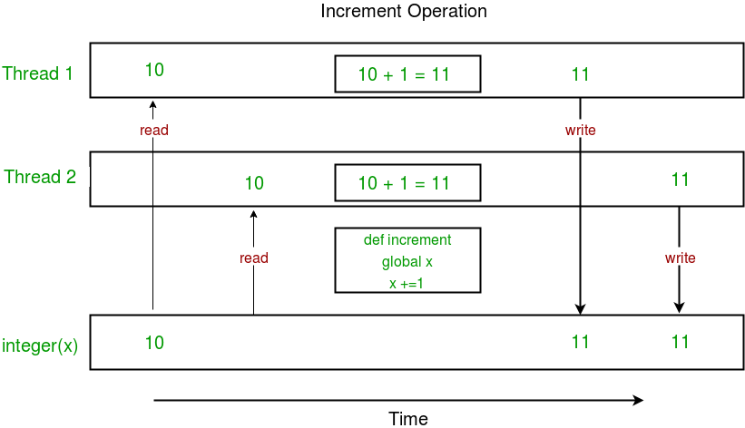
Race Condition
Concurrent accesses to shared resource can lead to race condition.
A race condition occurs when two or more threads can access shared data and they try to change it at the same time. As a result, the values of variables may be unpredictable and vary depending on the timings of context switches of the processes
Run a sample Program

Slide 11
Problem--Deadlock
A situation involving two or more threads (processes) in which no thread may proceed because each is waiting for a resource held by another
Can be represented by a resource allocation graph
Thread Synchronization with Lock and RLock
wants
lock_b
held by
Thread 1
Thread 2
lock_a
held by
wants
Notes:
When two or more operations belonging to concurrent threads try to access the shared memory and at least one of them has the power to change the status of the data without a proper synchronization mechanism a race condition can occur and it can produce invalid code execution and bugs and unexpected behavior.
The easiest way to get around the race conditions is the use of a lock. The operation of a lock is simple; when a thread wants to access a portion of shared memory, it must necessarily acquire a lock on that portion prior to using it.
In addition to this, after completing its operation, the thread must release the lock that was previously obtained so that a portion of the shared memory is available fro any other threads that want to use it. In this way it is evident that the impossibility of incurring races is critical as the need of the lock for the thread requires that t a given instant, only a given thread can use this part of the shared memory. Despite their simplicity, the use of a lock works. However, in practice, we can see how this approach can often lead the execution to a bad situation of deadlock.
A deadlock occurs due to the acquisition of a lock from different threads; it is impossible to proceed with the execution of operations since the various locks between them block access to the resources.
Data Dependency
Work on deadlock goes back to the 1960s and the development of multi programmed operating systems. The problems are familiar, and the solutions are worked out.

Slide 12
Four Conditions for Deadlock
Mutually exclusive access to a resource
Mutual exclusion is a property of concurrency control, which prevents race conditions.
It is the requirement that one thread of execution never enters its critical section at the same time that another concurrent thread of execution enters its own critical section, which refers to an interval of time during which a thread of execution accesses a shared resource, such as shared memory.
Threads hold onto resources they have while they wait for additional resources
Resources cannot be taken away from threads
Cycle in resource allocation graph
Notes:
These conditions are necessary, but not sufficient.
Here’s a Windows-specific variant of the second condition. If a thread exits without releasing all the locks it is holding, that’s just as bad as a thread holding onto a lock waiting for another one. Another case would be a thread simply “forgetting” to release a lock. These ideas will be raised a few slides from now.

Slide 13
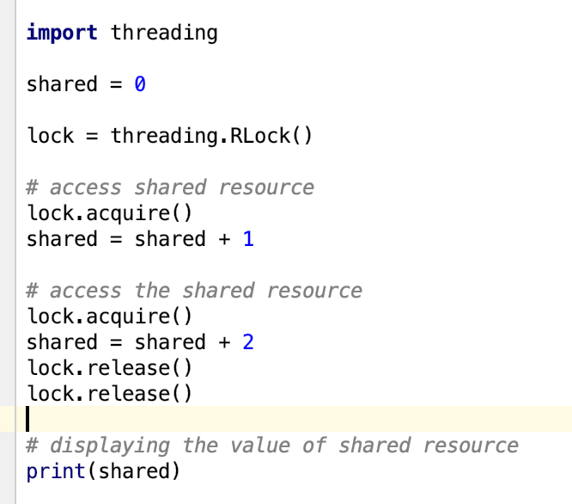
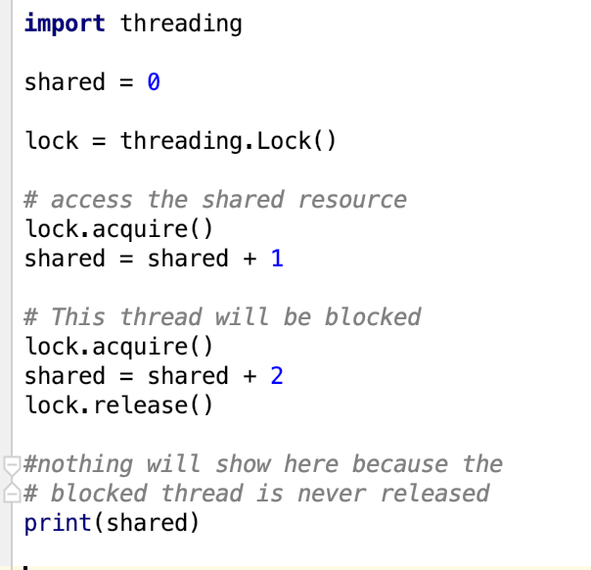
RLock vs Lock
Notes:
Locks have two states: locked and unlocked
We have two methods that are used to manipulate the locks: acquire() and release()
The following are the rules:
If the state is unlocked, a call to acquire() changes the state to locked.
If the state is locked, a call to acquire() blocks until another thread calls release()
If the state is unlocked, a call to release() raises a RuntimeError exception
If the state is locked, a call to release() changes the state to unlocked.

Slide 14
Python Rlock vs. Lock
Any thread can release the acquired lock.
If we want only the thread that acquires a lock to release it, we must use Rlock objects
Lock cannot be acquired again, unless it is being released
Locks help us in efficiently accessing a shared resource in a program in order to prevent corruption of data, it follows mutual exclusion as only one thread can access a particular resource at a time.
The RLocked resource can be accessed repeatedly by various threads
Rlock() is useful when you want to have a thread-safe access from outside the class and use the same methods from inside the class

Slide 15
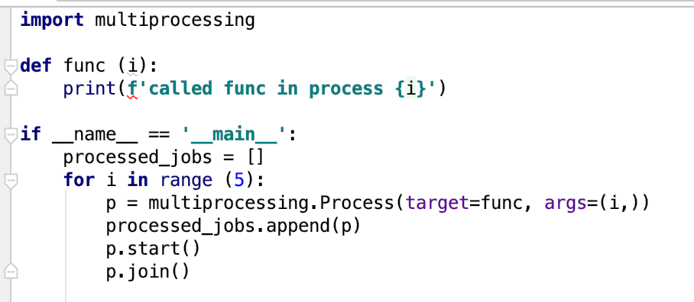
Python Multiprocessing
Notes:
called func in process 0
called func in process 1
called func in process 2
called func in process 3
called func in process 4

Slide 16
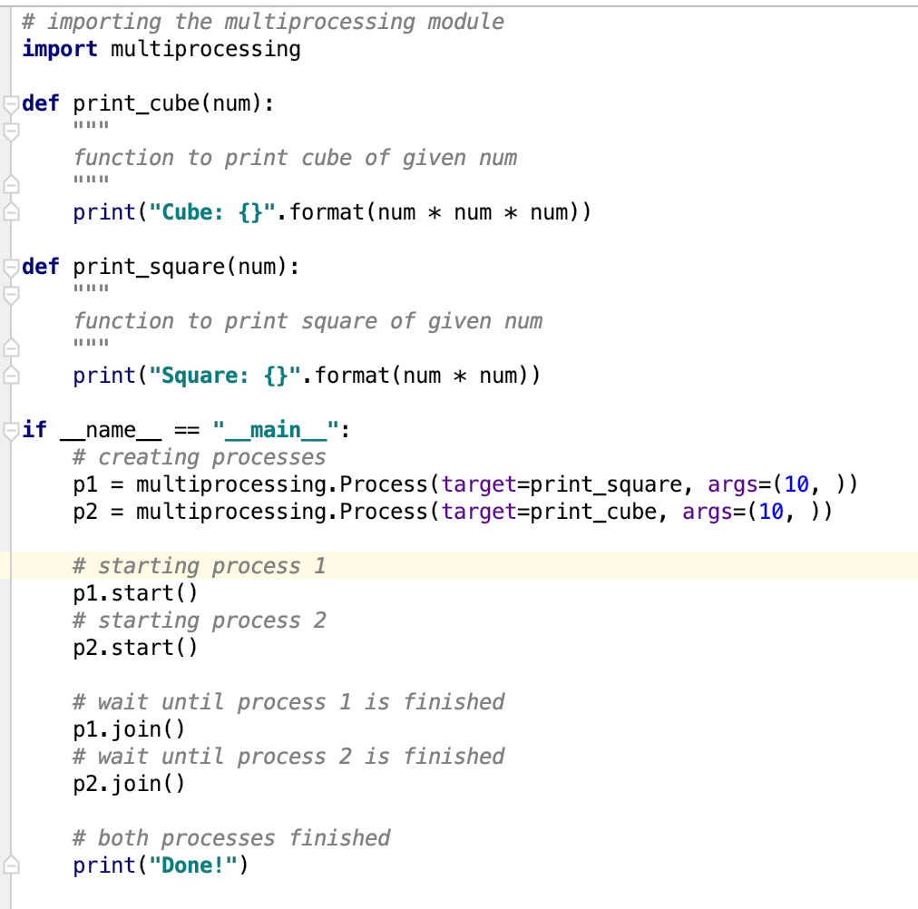
Multiprocessing

Slide 17
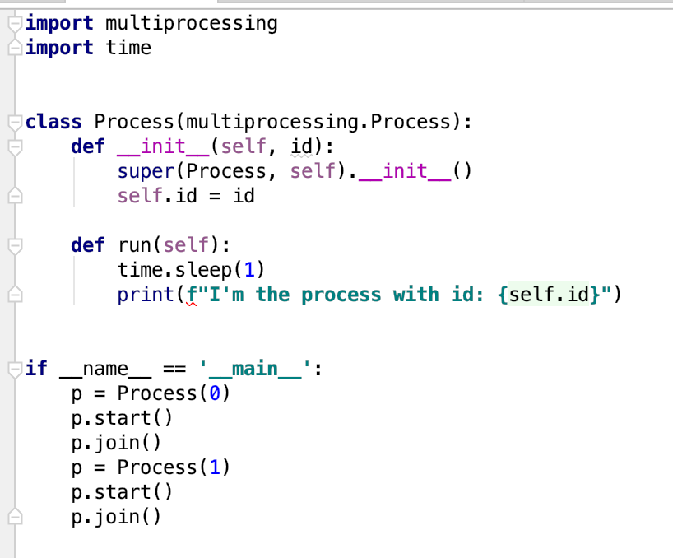
Multiprocessing with a class
Notes:
I'm the process with id: 0
I'm the process with id: 1

Slide 18

Multiprocessing with the Pool class
Pool class can be used for parallel execution of a function for different input data. The multiprocessing.Pool() class spawns a set of processes called workers and can submit tasks using the methods apply/apply_async and map/map_async. For parallel mapping, you should first initialize a multiprocessing.Pool() object. The first argument is the number of workers; if not given, that number will be equal to the number of cores in the system.

Slide 19
Synchronous and Asynchronous Execution
A synchronous execution is one the processes are completed in the same order in which it was started. This is achieved by locking the main program until the respective processes are finished.
Asynchronous, on the other hand, doesn’t involve locking. As a result, the order of results can get mixed up but usually gets done quicker.
Pool Class
Synchronous execution
Pool.map() and Pool.starmap()
Pool.apply()
Asynchronous execution
Pool.map_async() and Pool.starmap_async()
Pool.apply_async())

Slide 20
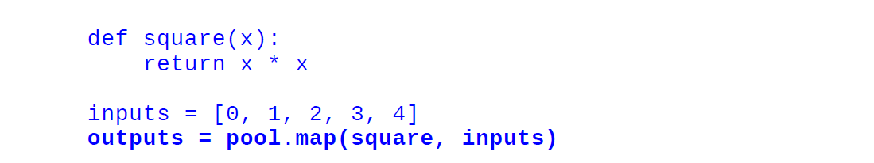
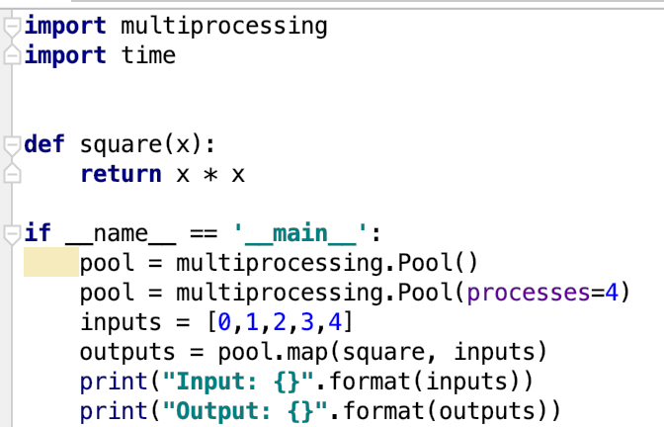
Pool class
Let see by an example. In this example, we will see how to pass a function which computes the square of a number. Using Pool.map() you can map the function to the list and passing the function and the list of inputs as arguments, as follows:

Slide 21
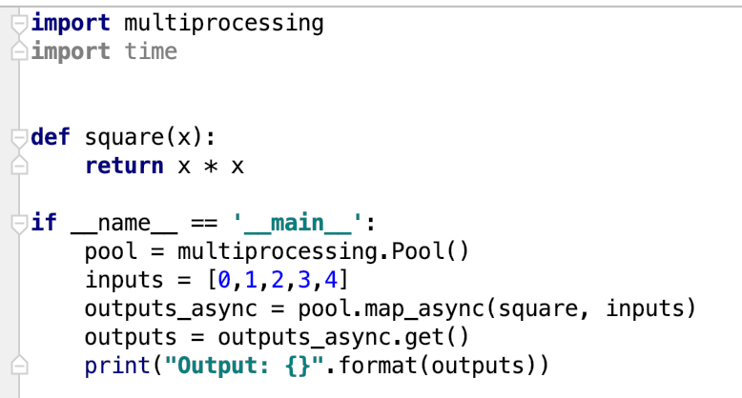

Asynchronous output
When we use the normal map method, the execution of the program is stopped until all the workers completed the task. Using map_async(), the AsyncResult object is returned immediately without stopping the main program and the task is done in the background. The result can be retrieved by using the AsyncResult.get() method at any time as shown below:

Slide 22
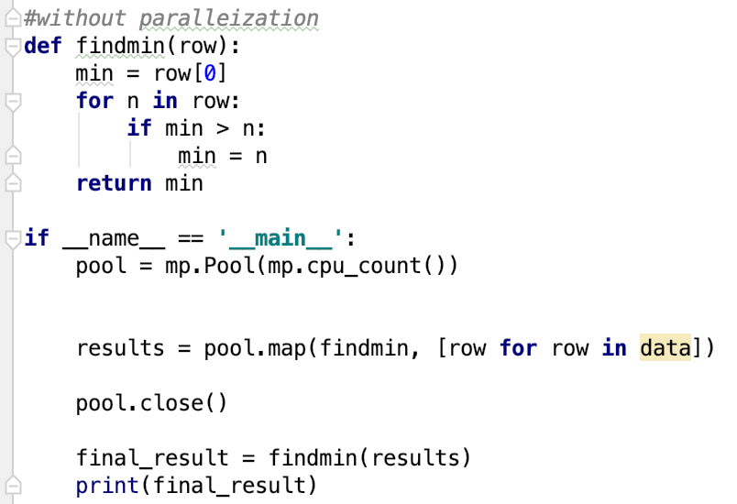
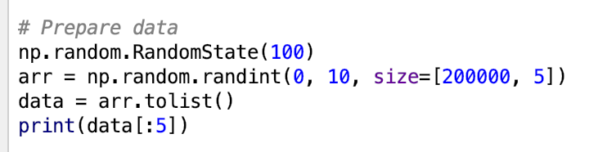
Example
A large set of data

Slide 23
Assignment 12
Implement a parallel version of “find_sum”,
Given a large set of randomly generated numbers (5 rows and 10,000,000 columns per row)
Find the sum

Slide 24
Useful resources:
https://www.hitechnectar.com/blogs/distributed-vs-parallel-computing/

